Slide 1
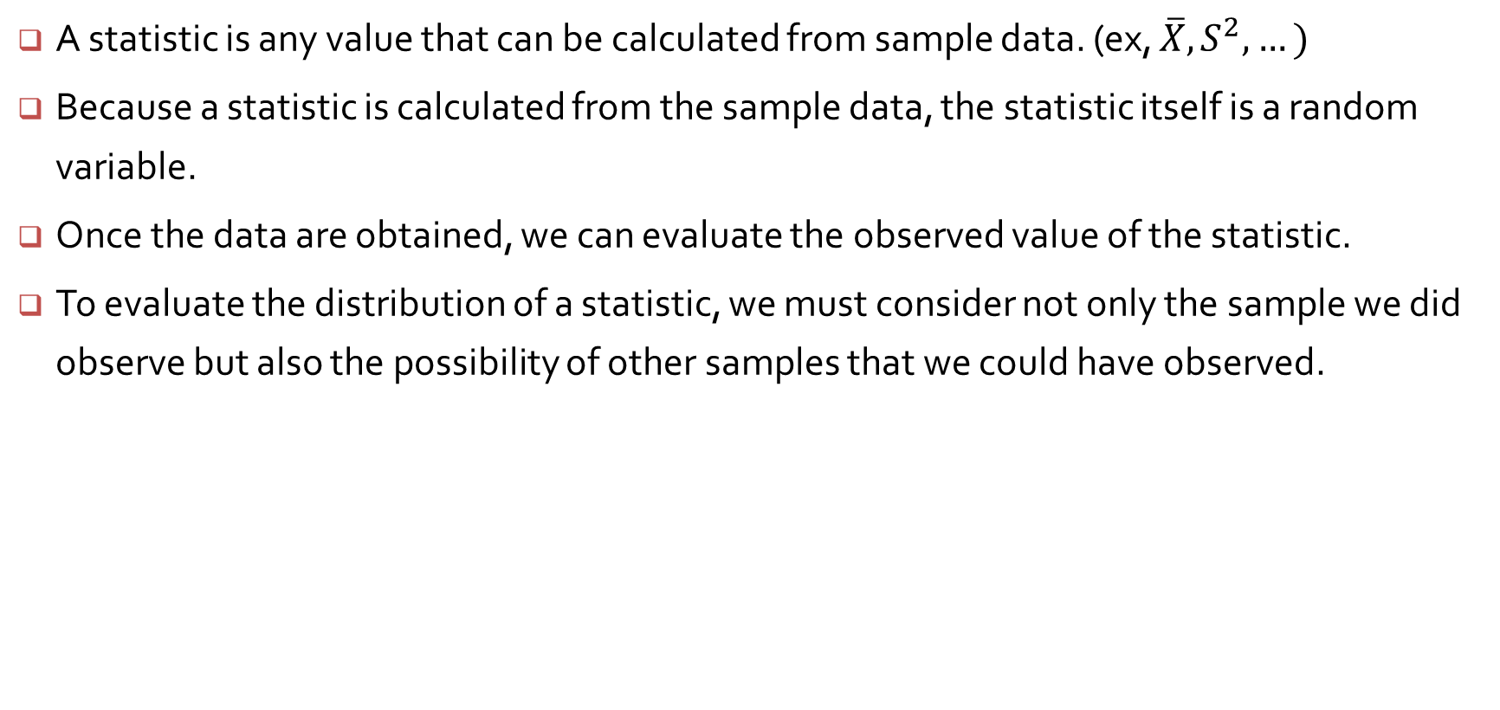
Definition of a statistic
A statistic is any value that can be calculated from sample data. (ex, $\overline{X}, S^{2},…)$
Because a statistic is calculated from the sample data, the statistic itself is a random variable.
Once the data are obtained, we can evaluate the observed value of the statistic.
To evaluate the distribution of a statistic, we must consider not only the sample we did observe but also the possibility of other samples that we could have observed.

Slide 2
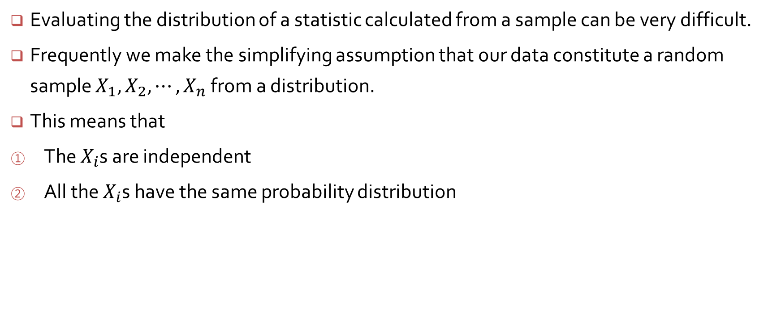
Random samples
Evaluating the distribution of a statistic calculated from a sample can be very difficult.
Frequently we make the simplifying assumption that our data constitute a random sample $X_{1},$ $X_{2},⋯, X_{n}$ from a distribution.
This means that
The $X_{i}$s are independent
All the $X_{i}$s have the same probability distribution

Slide 3
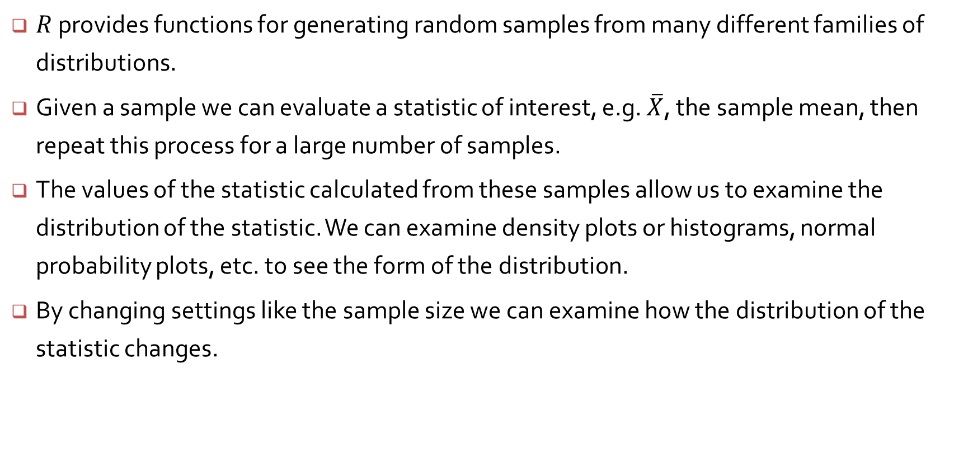
Simulation experiments
$R$ provides functions for generating random samples from many different families of distributions.
Given a sample we can evaluate a statistic of interest, e.g. $\overline{X}$, the sample mean, then repeat this process for a large number of samples.
The values of the statistic calculated from these samples allow us to examine the distribution of the statistic. We can examine density plots or histograms, normal probability plots, etc. to see the form of the distribution.
By changing settings like the sample size we can examine how the distribution of the statistic changes.

Slide 4
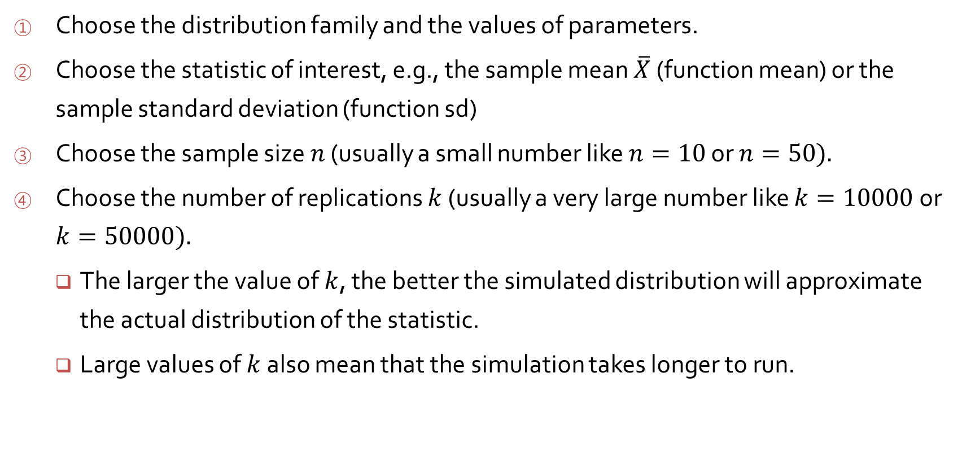
Steps in a simulation experiment
Choose the distribution family and the values of parameters.
Choose the statistic of interest, e.g., the sample mean $\overline{X}$ (function mean) or the sample standard deviation (function sd)
Choose the sample size $n$ (usually a small number like $n=10$ or $n=50).$
Choose the number of replications $k$ (usually a very large number like $k=10000$ or $k=50000).$
The larger the value of $k$, the better the simulated distribution will approximate the actual distribution of the statistic.
Large values of $k$ also mean that the simulation takes longer to run.

Slide 5
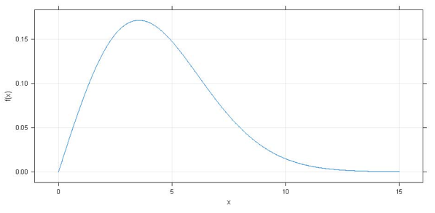

Simulating a sample mean from a Weibull Distribution
Consider the Weibull distribution with parameters $α=2$ (the shape parameter) and $β=5$ (the scale parameter) shown below
$$f\left(x;α,β\right)=\left\{\begin{matrix}\frac{α}{β^{α}}x^{α−1}e^{−{\left(x/β\right)}^{α}} & x≥0 \\ 0 & otherwise\end{matrix}\right.$$

Slide 6
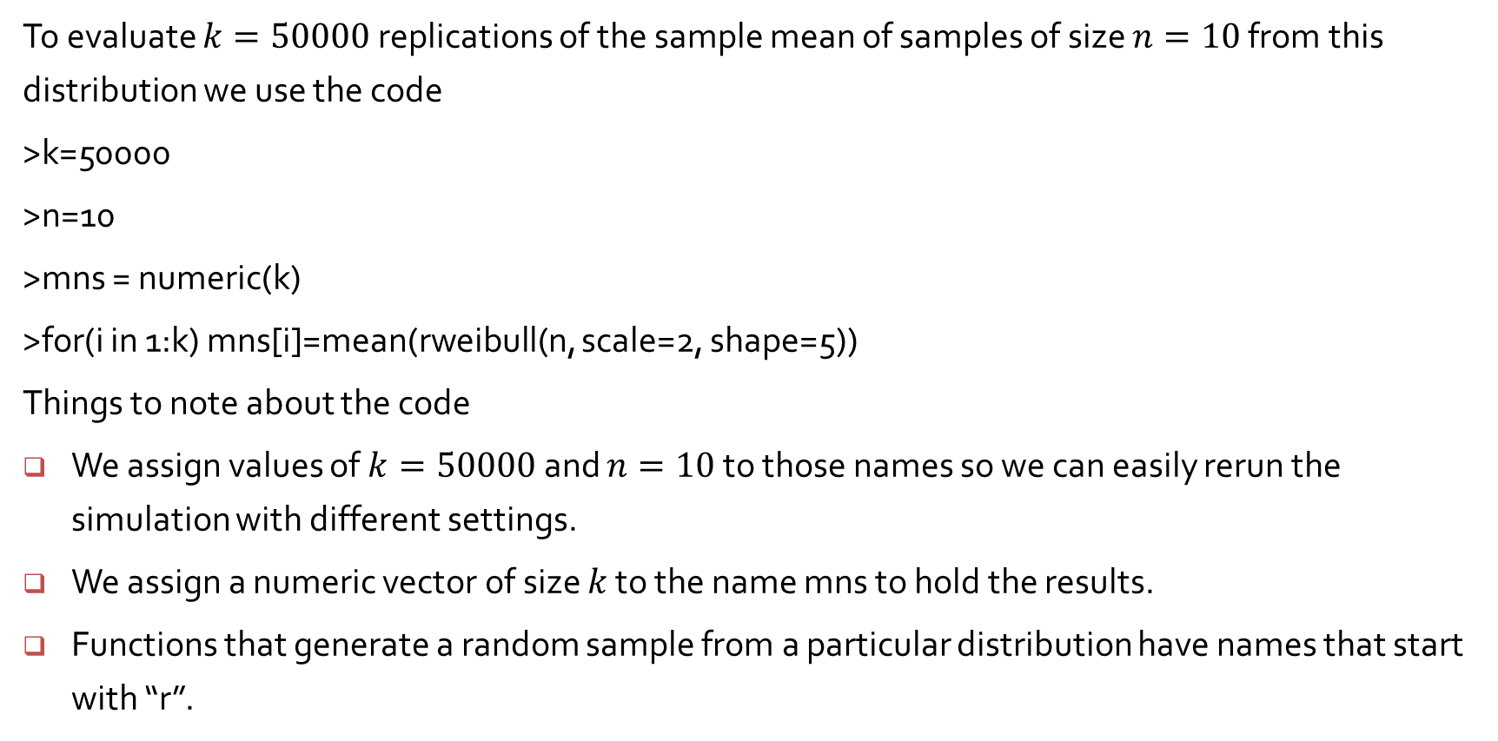
Simulating a sample mean from a Weibull Distribution (cont’d)
To evaluate $k=50000$ replications of the sample mean of samples of size $n=10$ from this distribution we use the code
>k=50000
>n=10
>mns = numeric(k)
>for(i in 1:k) mns[i]=mean(rweibull(n, scale=2, shape=5))
Things to note about the code
We assign values of $k=50000$ and $n=10$ to those names so we can easily rerun the simulation with different settings.
We assign a numeric vector of size $k$ to the name mns to hold the results.
Functions that generate a random sample from a particular distribution have names that start with “r”.

Slide 7
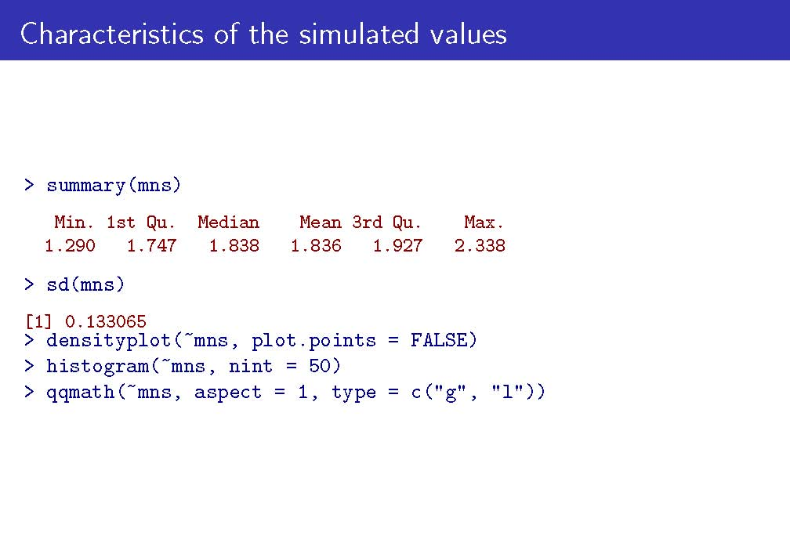

Slide 8
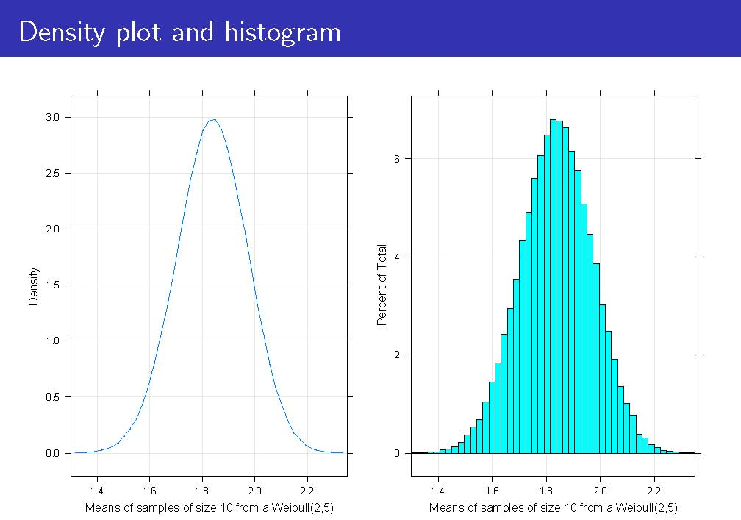

Slide 9
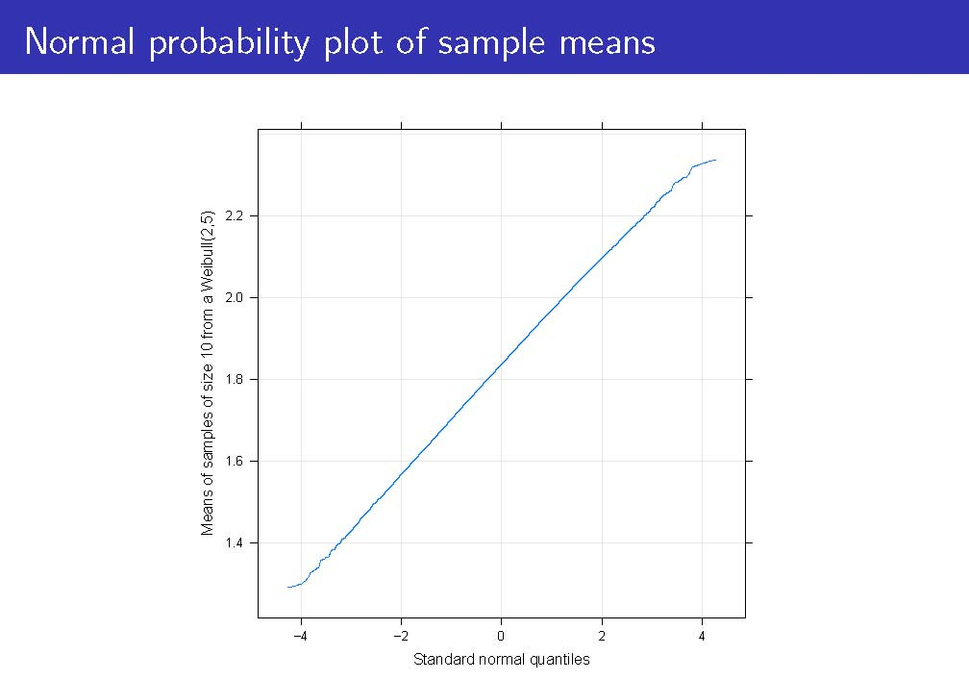

Slide 10
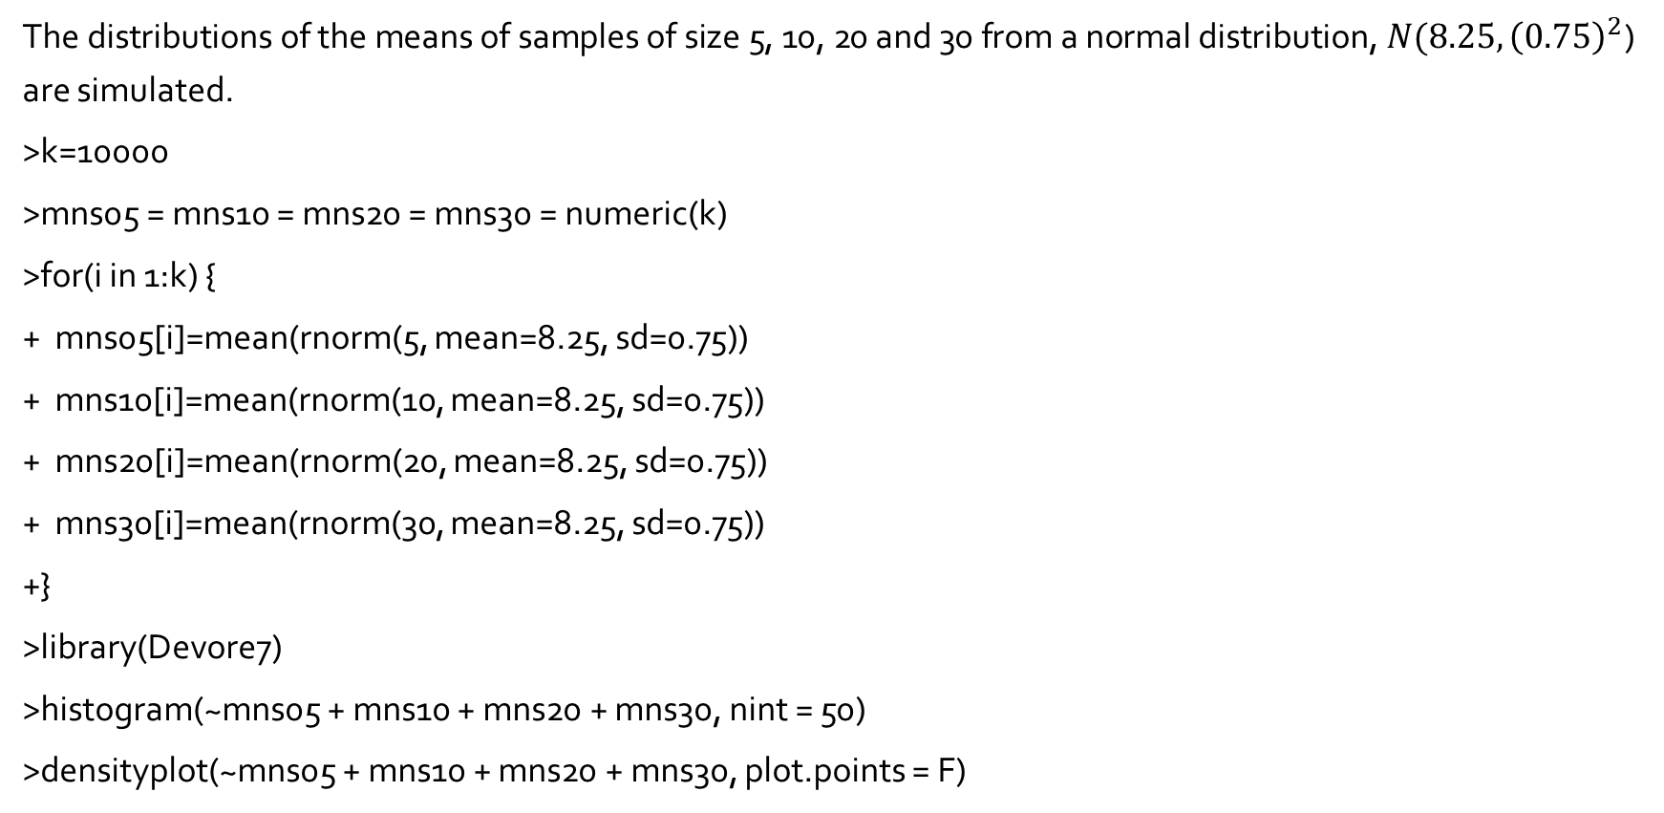
Multiple sample sizes : example 5.22
The distributions of the means of samples of size 5, 10, 20 and 30 from a normal distribution, $N(8.25, {\left(0.75\right)}^{2}$) are simulated.
>k=10000
>mns05 = mns10 = mns20 = mns30 = numeric(k)
>for(i in 1:k) {
+ mns05[i]=mean(rnorm(5, mean=8.25, sd=0.75))
+ mns10[i]=mean(rnorm(10, mean=8.25, sd=0.75))
+ mns20[i]=mean(rnorm(20, mean=8.25, sd=0.75))
+ mns30[i]=mean(rnorm(30, mean=8.25, sd=0.75))
+}
>library(Devore7)
>histogram(~mns05 + mns10 + mns20 + mns30, nint = 50)
>densityplot(~mns05 + mns10 + mns20 + mns30, plot.points = F)

Slide 11
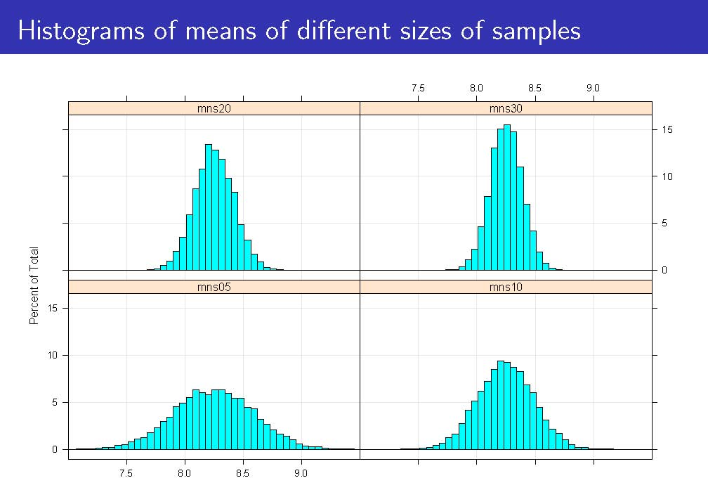

Slide 12
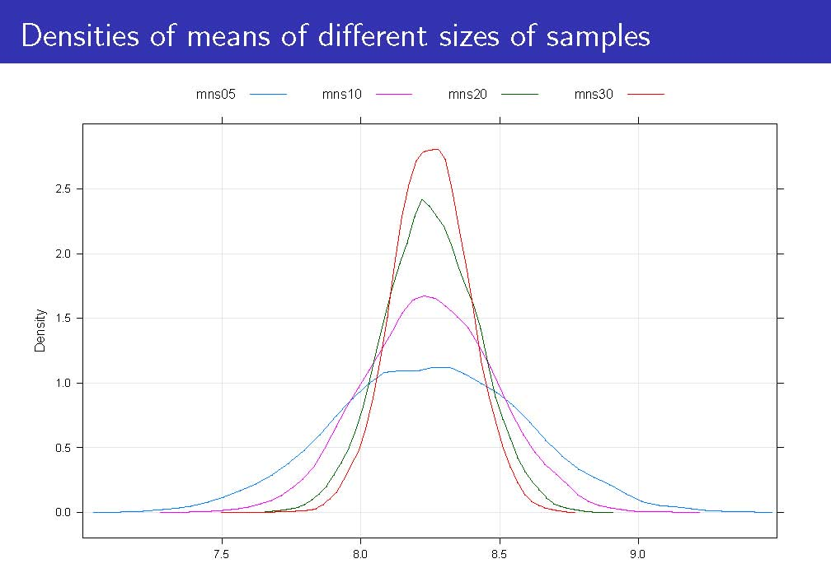

Slide 13
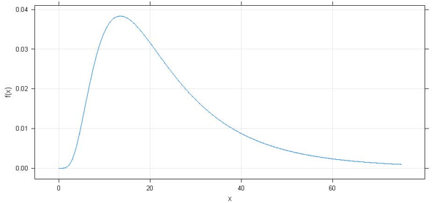

Example 5.23 – Simulating from a skewed distribution
The means of samples of different sizes from a log-normal distribution with
$E[\ln{X]}=3$ and$Var[\ln{X]}=0.4$ are simulated.

Slide 14
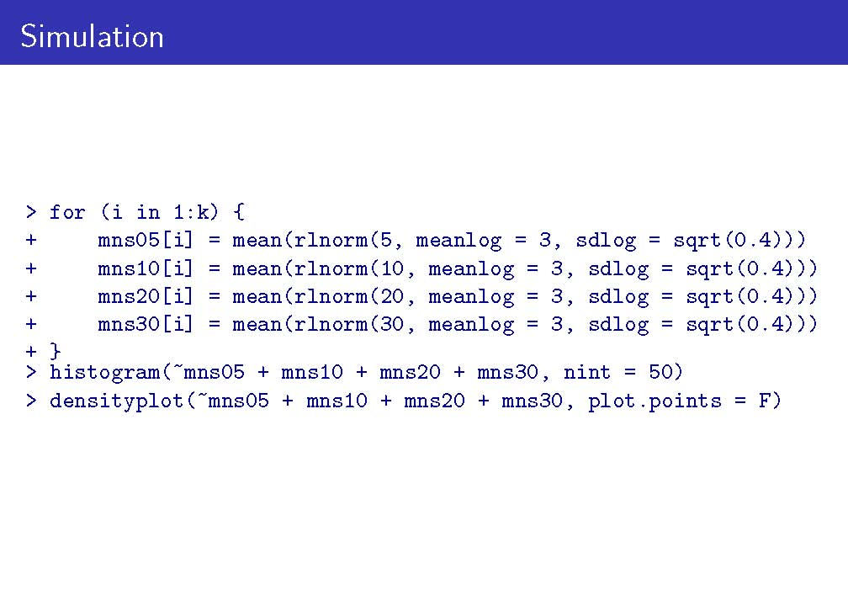

Slide 15
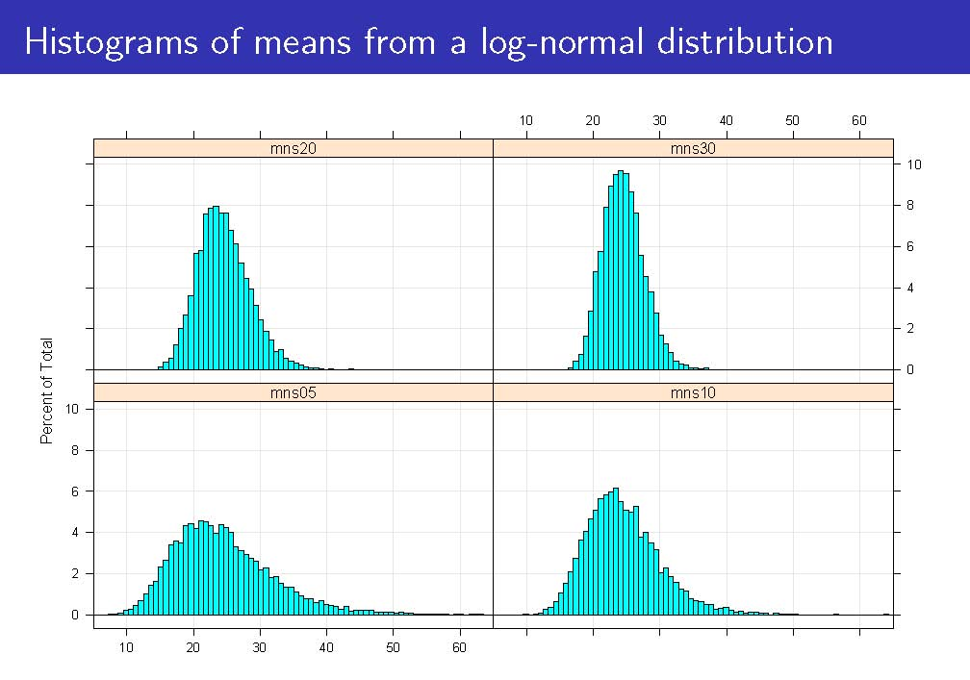

Slide 16
